Slide 1


EPIGENOMICS DATA INTEGRATION
PROJECT IN MOLECULAR LIFE SCIENCE
Students: Fernando Pérez Gómez
Fuqi Xu
Supervisors: Simon Elsässer
Carmen Navarro Luzón
11/09/2018

Slide 2
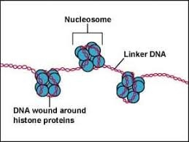
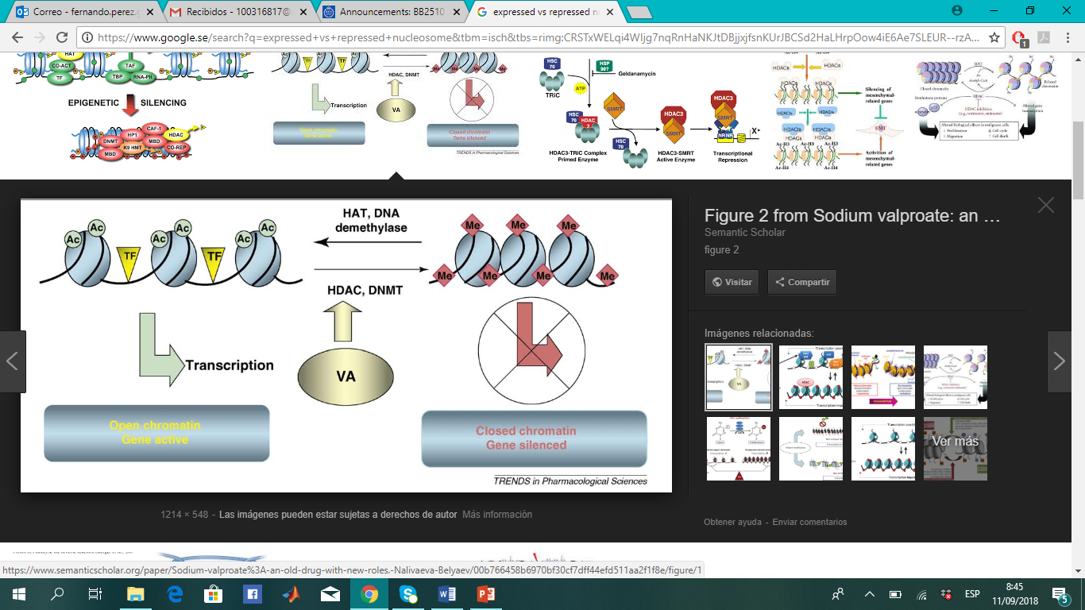


INTRODUCTION
DNA + Histones$→$ Nucleosomes
Nucleosomes as access barriers
Repressed genes
Expressed genes
https://www.quora.com/What-are-the-largest-nucleosomes-in-human-chromosomes-and-are-the-histones-and-nucleosomes-are-equal
Nalivaeva, Natalia N. et al. “Sodium valproate: an old drug with new roles.” Trends in pharmacological sciences 30 10 (2009): 509-14.

Slide 3
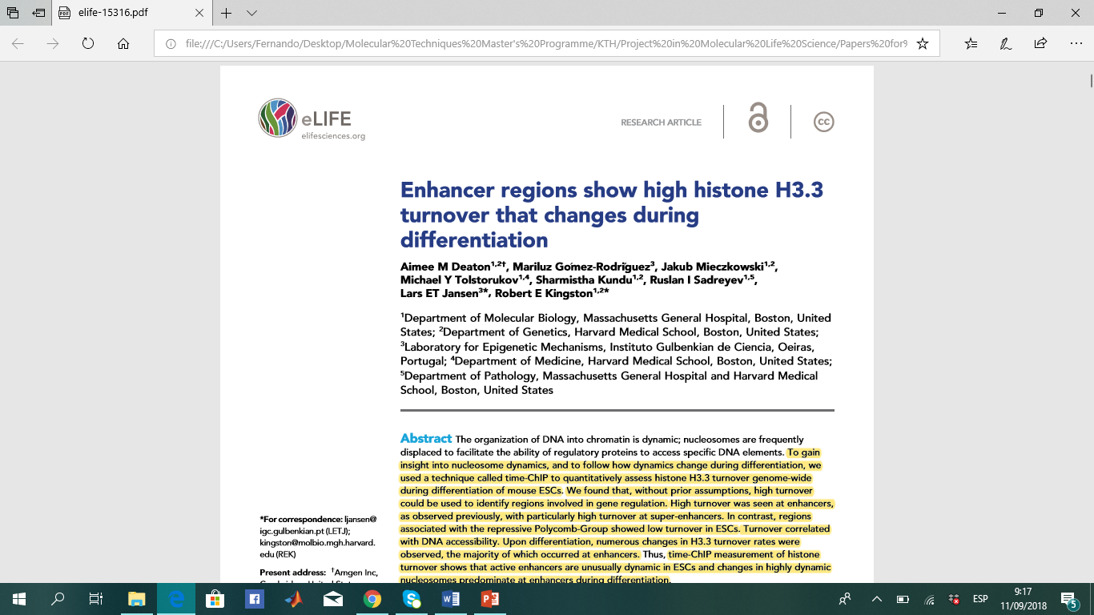
BRIEF DESCRIPTION
Quantitative assessment of H3.3 turnover genome-wide
Generated dataset
Bioinformatics pipeline
Visualization + Analysis
Deaton, Aimee M, et al. “Enhancer Regions Show High Histone H3.3 Turnover That Changes during Differentiation.” ELife, vol. 5, 2016, doi:10.7554/elife.15316.

Slide 4
METHODS
ChIP-seq analysis
Turnover index (TI) calculation
Identification of top TI regions
Detecting differences in TI between ESCs and NSCs

Slide 5
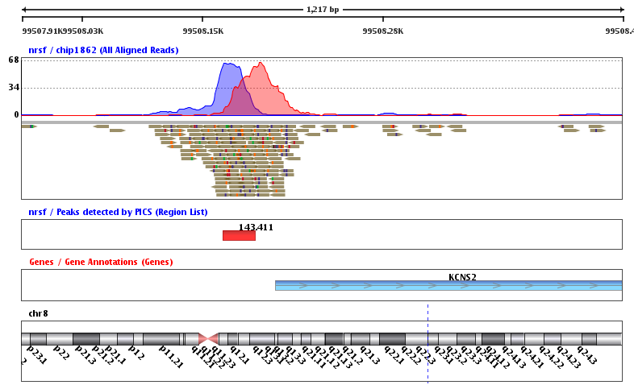
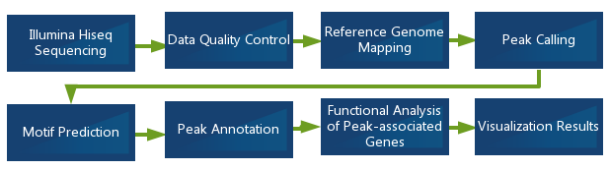
METHODS
ChIP-seq analysis

Slide 6
THANK YOU!

